Slide 1

CS 6140:
Machine Learning
Presented by: Dr. Tala Khoei

Slide 2
Introduction to Time Series Models

Slide 3
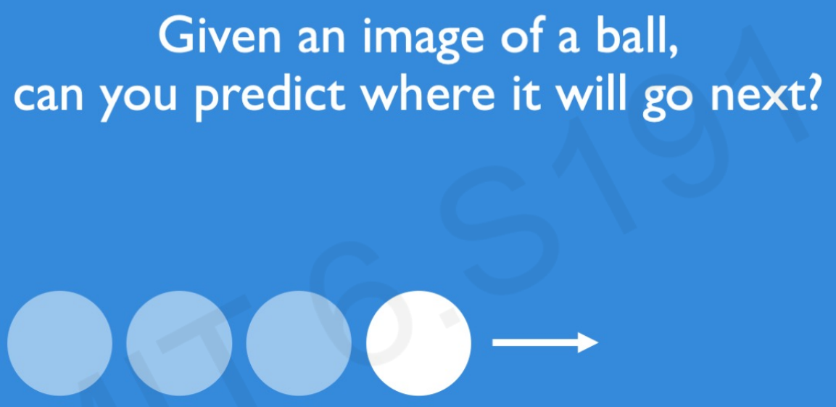
Sequence Modeling
Sequential modeling is the process of building models that understand and generate data in a specific order or sequence, which is essential for tasks where the arrangement of elements (like words, time steps, or events) matters.

Slide 4
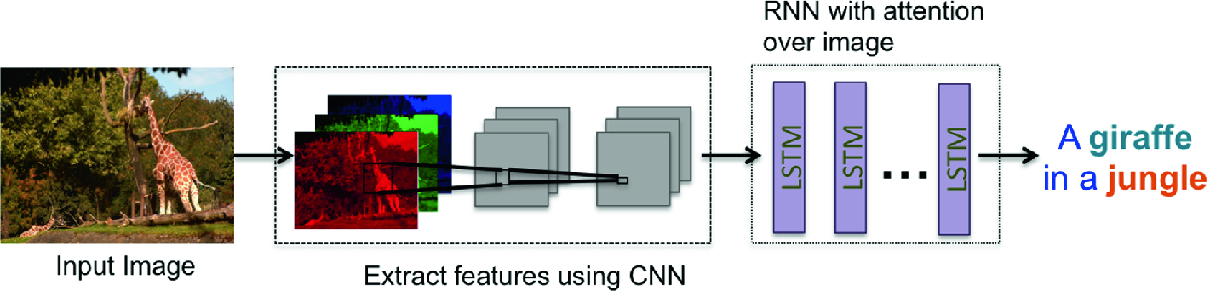
Sequence data
Some applications includes:
Image Captioning: caption an image by analyzing the present action.

Slide 5
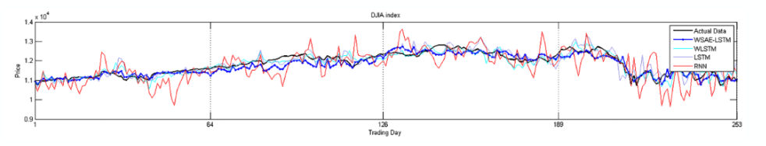
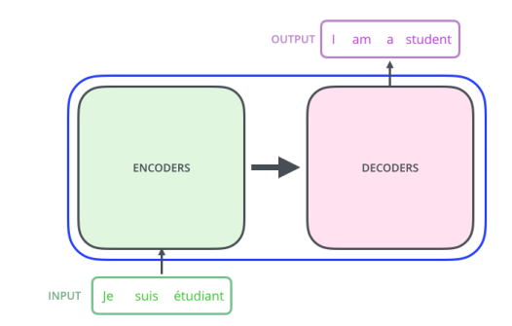
Sequence data
Time Series: prediction time series problem, e.g., stock market predictions.
Natural Language Processing: Text mining and Sentiment (e.g., sentiment analysis, or machine translation, and etc)

Slide 6
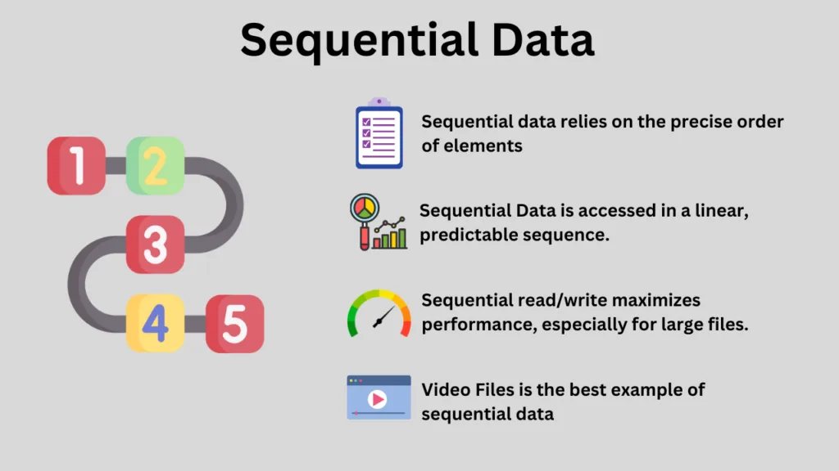
Sequential Data: Definition

Slide 7
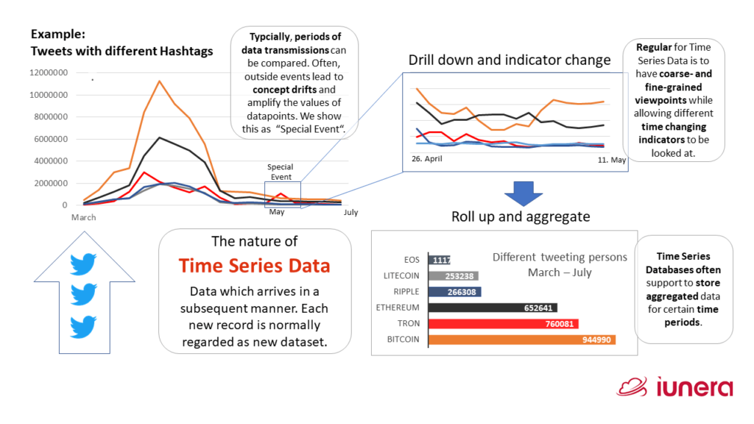
Introduction Time Series Models in Deep Learning
Time series forecasting is a statistical technique that analyzes sequential data to predict future events or trends.
This type of data is characterized by its chronological order, with each data point associated with a specific time interval. The essence of time series forecasting lies in understanding and leveraging the patterns found in historical data to foresee future occurrences.

Slide 8
Handling Complex Patterns
Scalability
End-to-End Learning
Handling Long-Term Dependencies:
Importance of Time Series Models in Deep Learning

Slide 9

What does Long-Term Dependencies Mean?
Long-term dependencies in sequential data refer to situations where the current value or state in a sequence is influenced by events or data points that occurred far earlier in the sequence.
A model needs to retain and consider information from previous time steps or observations over long periods of time in order to make an accurate prediction or decision. For example:
In time series forecasting, the value at time t may depend on data points from days, months, or years ago. Predicting tomorrow’s stock price might require considering patterns and trends from a year or more of historical data.

Slide 10
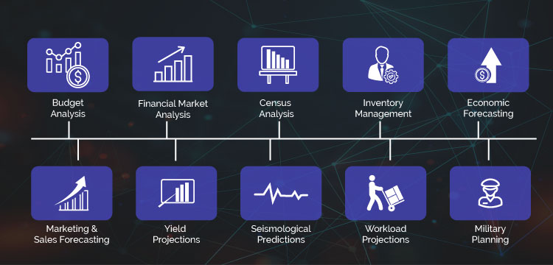
Example of Time Series Models in Deep Learning

Slide 11
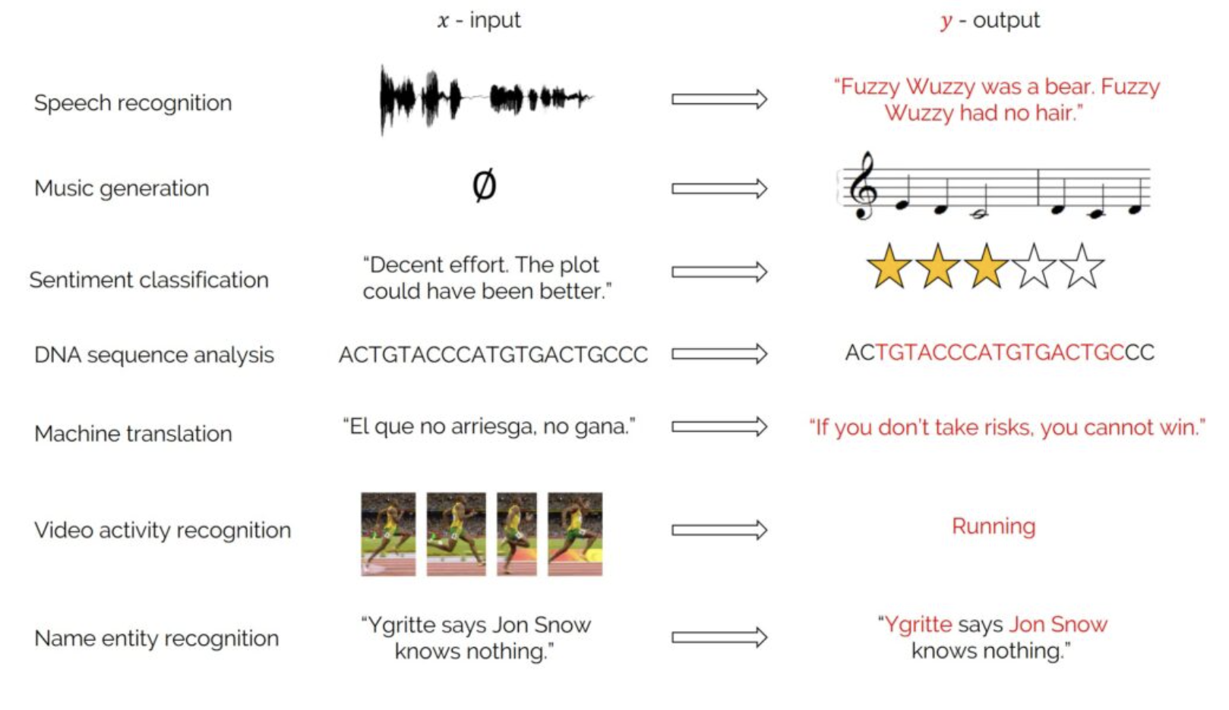

Slide 12
Introduction to Recurrent Neural Networks

Slide 13
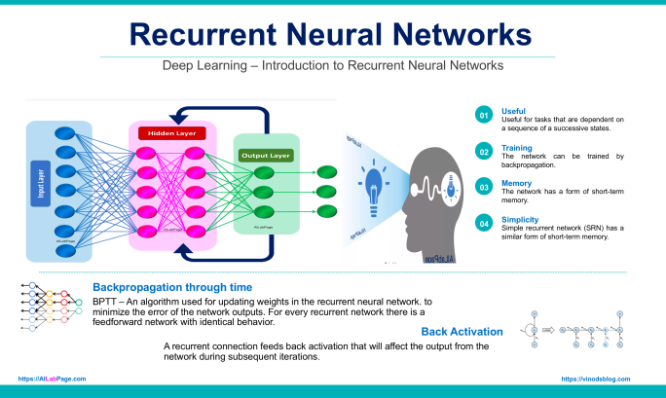
Recurrent Neural Networks
Recurrent neural networks (RNNs) are well-suited for processing sequences of data.
Unlike ANN, sequence modeling current output depends not only on current input but also on the previous output. This is the basic process of the family of RNNs.

Slide 14
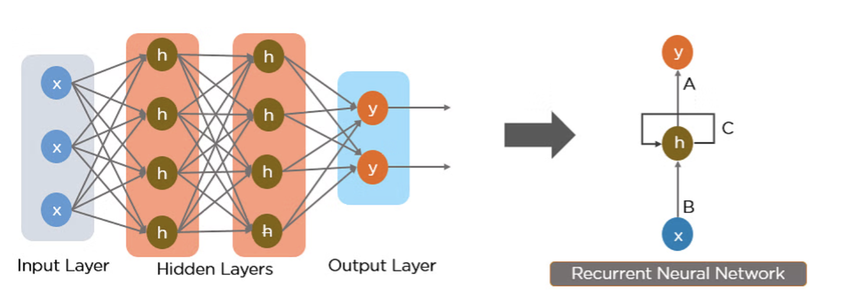

Slide 15
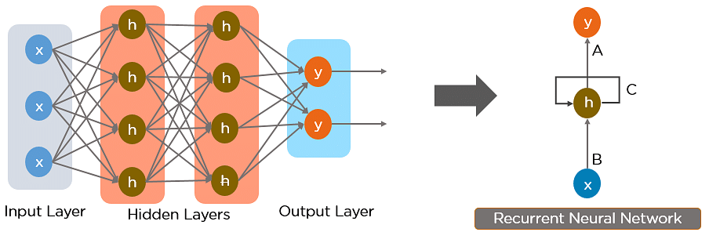
RNN works on the principle of saving the output of a particular layer and feeding this back to the input in order to predict the output of the layer.
The nodes in different layers of the neural network are compressed to form a single layer of recurrent neural networks. A, B, and C are the parameters of the network.
DNN
RNN

Slide 16
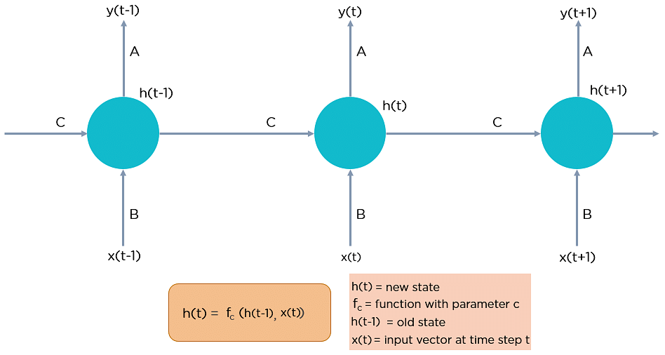
“x” is the input layer, “h” is the hidden layer, and “y” is the output layer. A, B, and C are the network parameters used to improve the output of the model.
At any given time t, the current input is a combination of input at x(t) and x(t-1). The output at any given time is fetched back to the network to improve on the output.

Slide 18
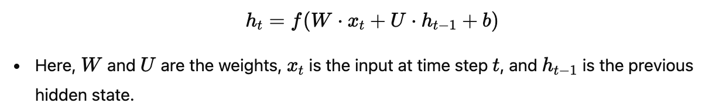
One of the key characteristics of Recurrent Neural Networks (RNNs) is their ability to remember information from previous time steps, which allows them to process sequential data.
The hidden state in an RNN serves as a kind of memory. It captures the information from earlier inputs and carries that memory forward as the network processes new inputs.
Mathematically, the memory is represented in the form of the hidden state ht, which is updated based on the current input xt and the previous hidden state ht−1​:
This feedback loop allows the RNN to "remember" the context of the previous inputs, which is crucial for tasks like language modeling, where understanding the relationship between words in a sentence depends on context.

Slide 19

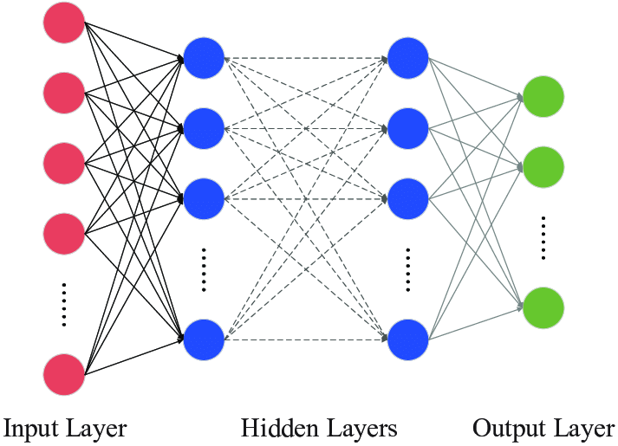
CNN vs DNN vs RNN
No Temporal Memory: In CNNs, the "memory" is limited to the local context (e.g., pixels), but it doesn’t account for temporal or sequential dependencies across time (like in video or text).
No Memory: in DNN, Once a layer processes a word (or input), it has no way to remember or use information about previous words.

Slide 20
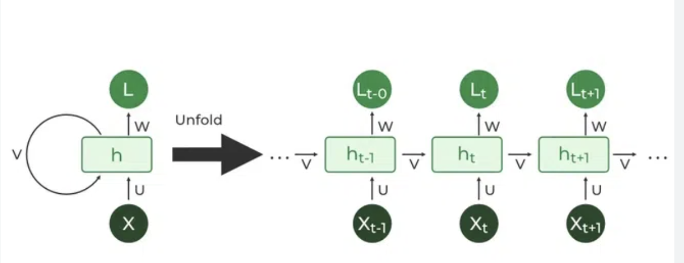
Temporal Memory: The memory in an RNN allows the network to "remember" the context of previous words, sounds, or events and use that context when processing new inputs.

Slide 21
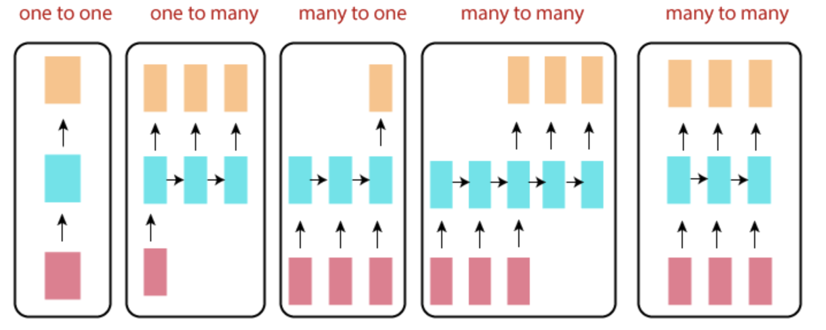
Types of RNN
The main reason that the recurrent nets are suitable models is that they allow us to operate over sequences of vectors: Sequence in the input, the output, or in the most general case, both.

Slide 22
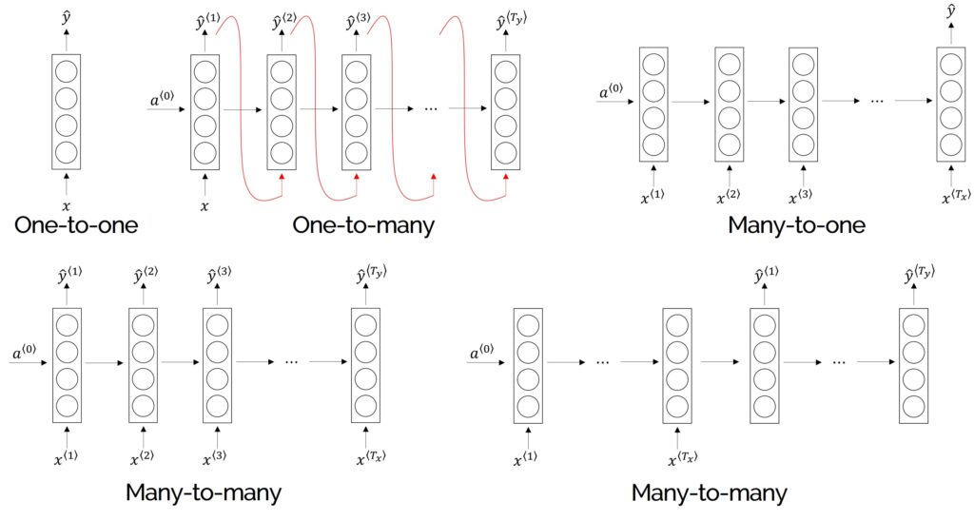

Slide 23
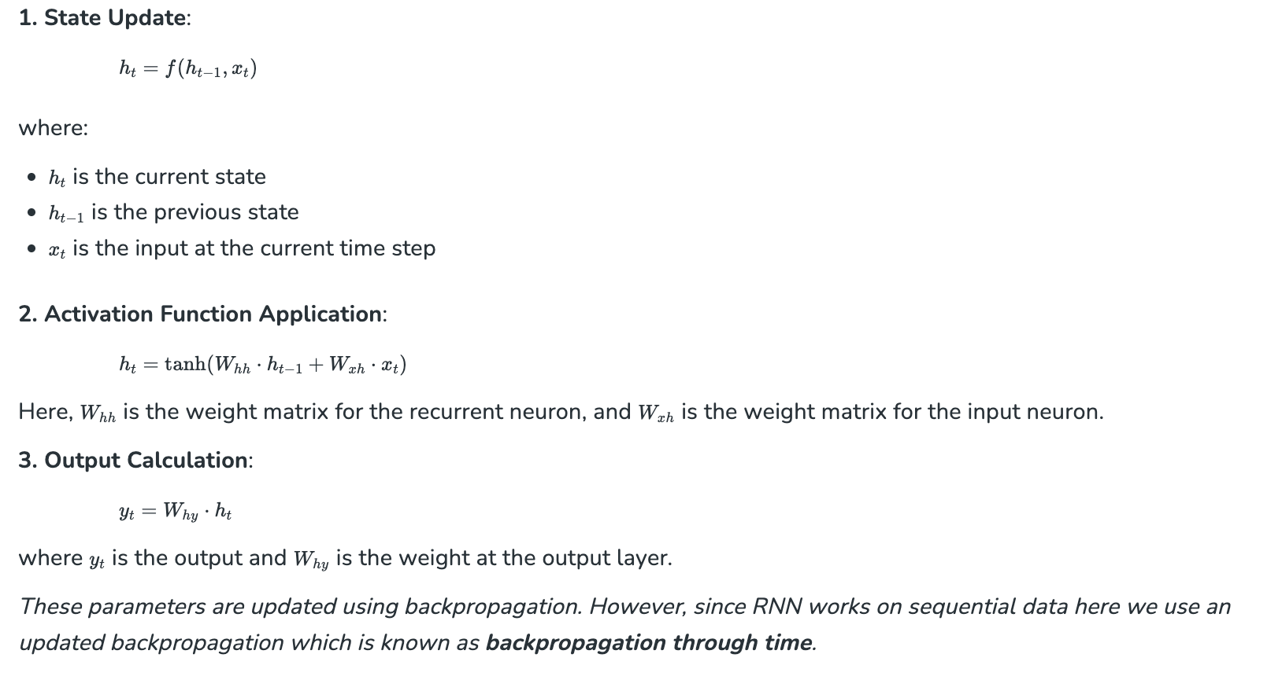
In General:

Slide 24
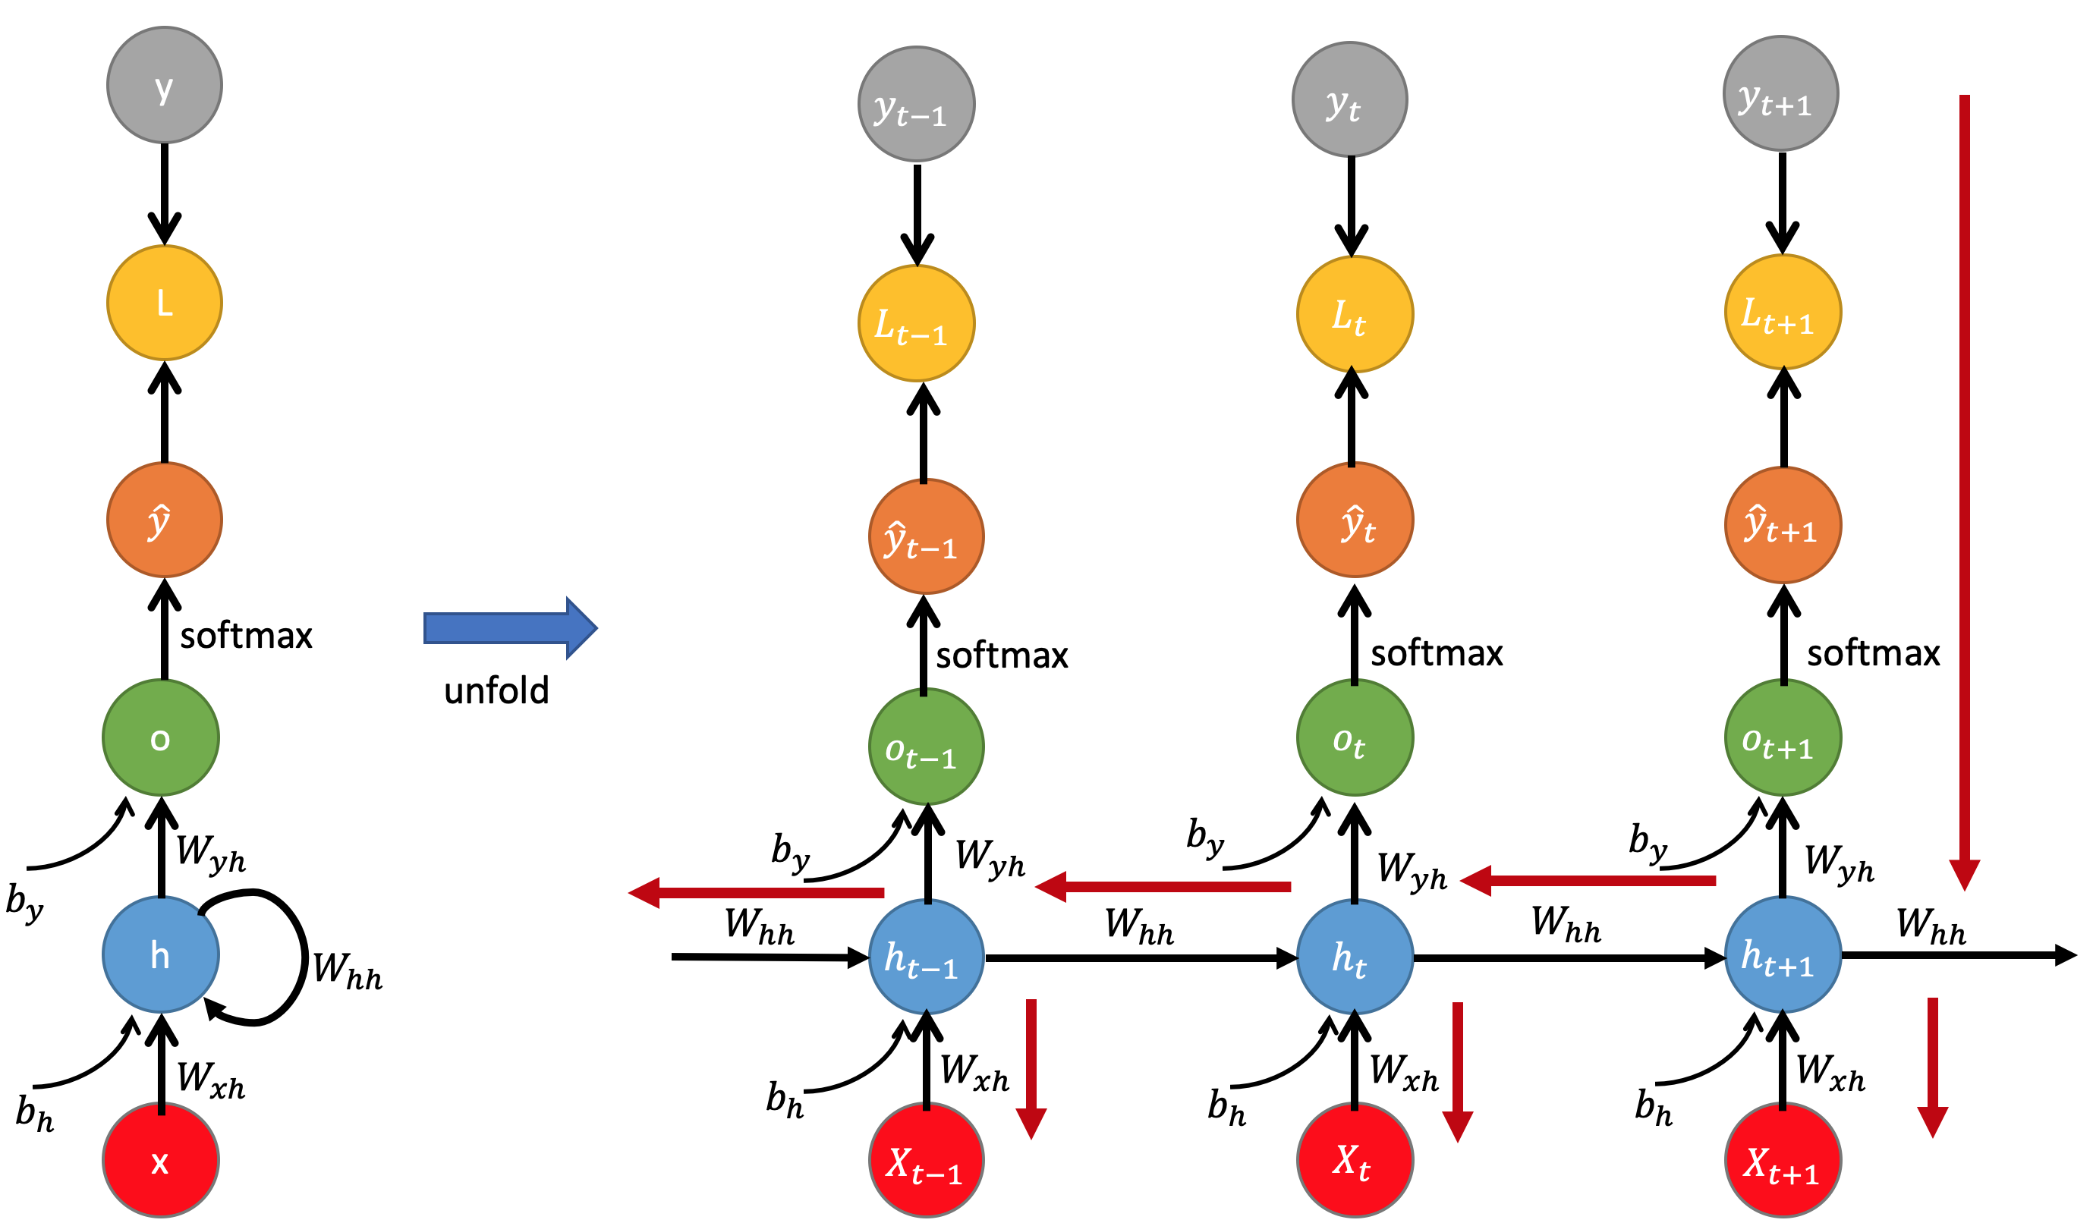
Backpropagation Through Time (BPTT) in RNNs
The RNN trains its units by adjusting their weights following a slight modification of a feedback process known as backpropagation.
The process of backpropagation works its way back, layer by layer, from the network’s final output, tweaking the weights of each unit, or artificial neuron, according to the unit’s calculated portion of the total output error.
Recurrent neural networks use a heavier version of this process known as back-propogation through time (BPTT). This version extends the tweaking process to include the weight of the T-1 input values responsible for each unit’s memory of the prior moment.

Slide 25
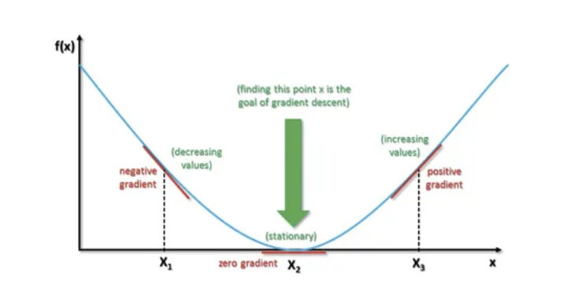
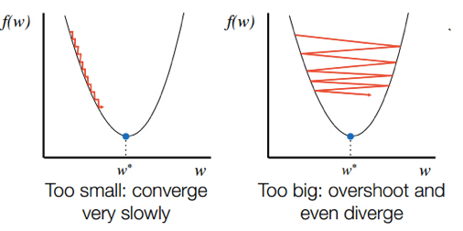
Limitations of RNN
During backpropagation, gradients can become too small, leading to the vanishing gradient problem, or too large, resulting in the exploding gradient problem as they propagate backward through time.
Vanishing and Exploding Gradient.
To address these problems, variations of RNN like Long-short term memory (LSTM) and Gated Recurrent Unit (GRU) networks have been introduced.

Slide 26
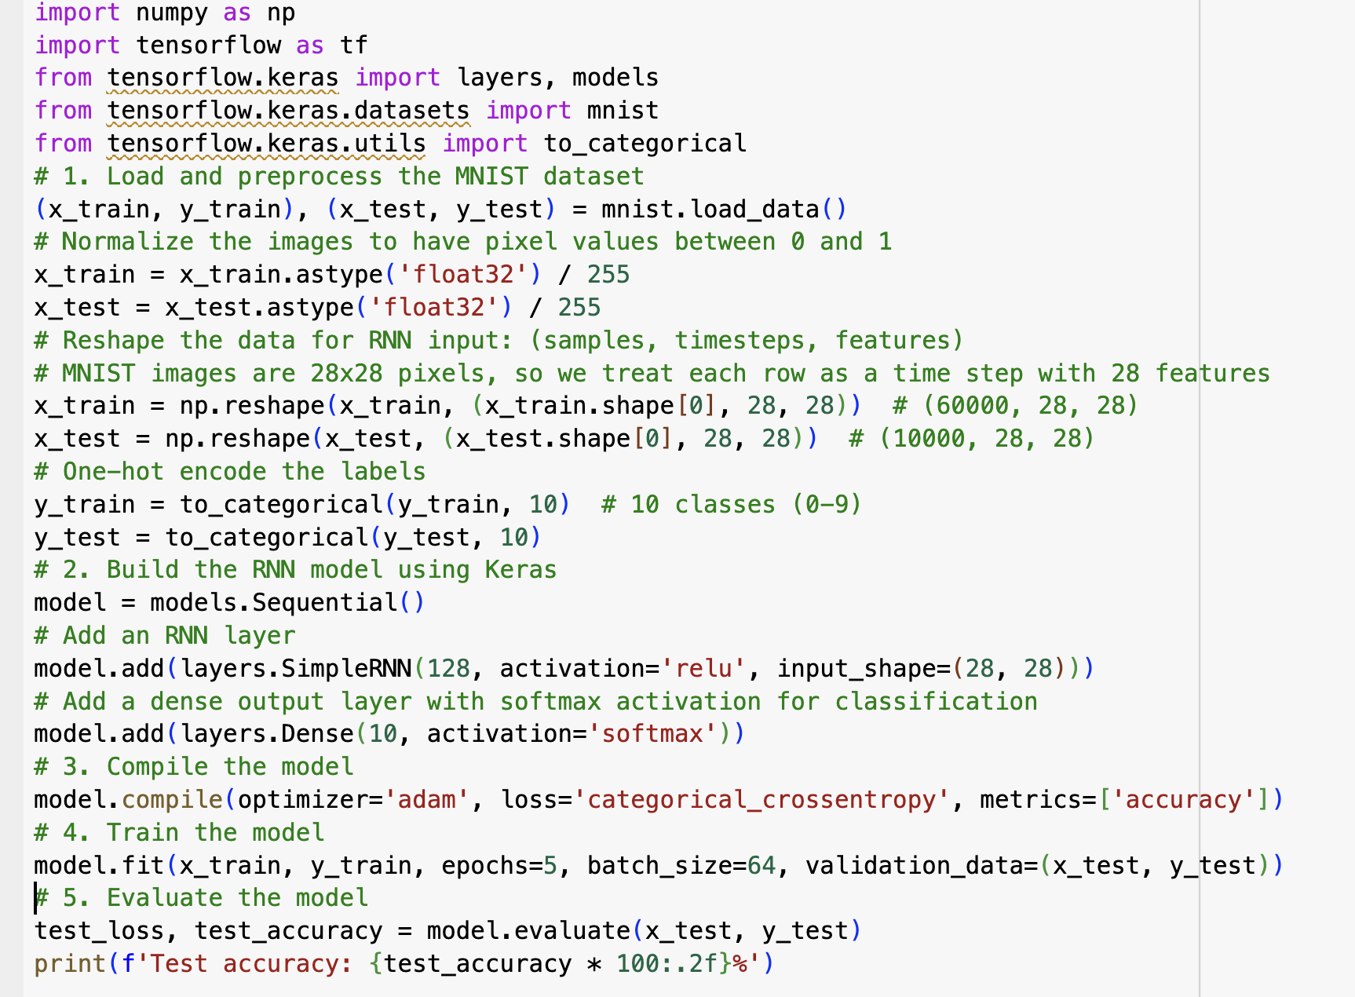
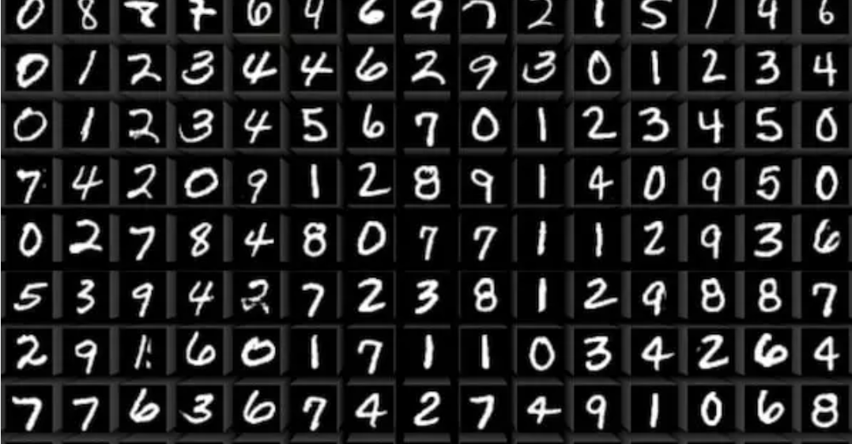
Simple RNN using Keras
Mnist Dataset
Please Refer to https://keras.io/api/layers/recurrent_layers/ to look at the details of the all possible Recurrent Layers in Keras.

Slide 27
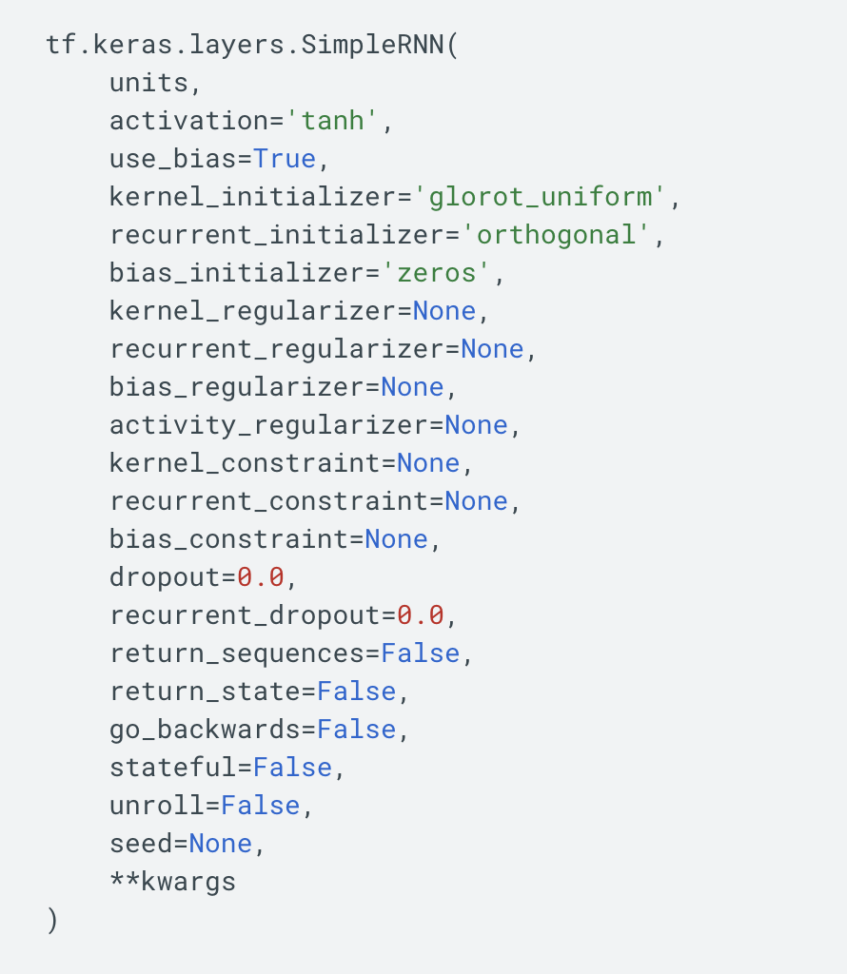
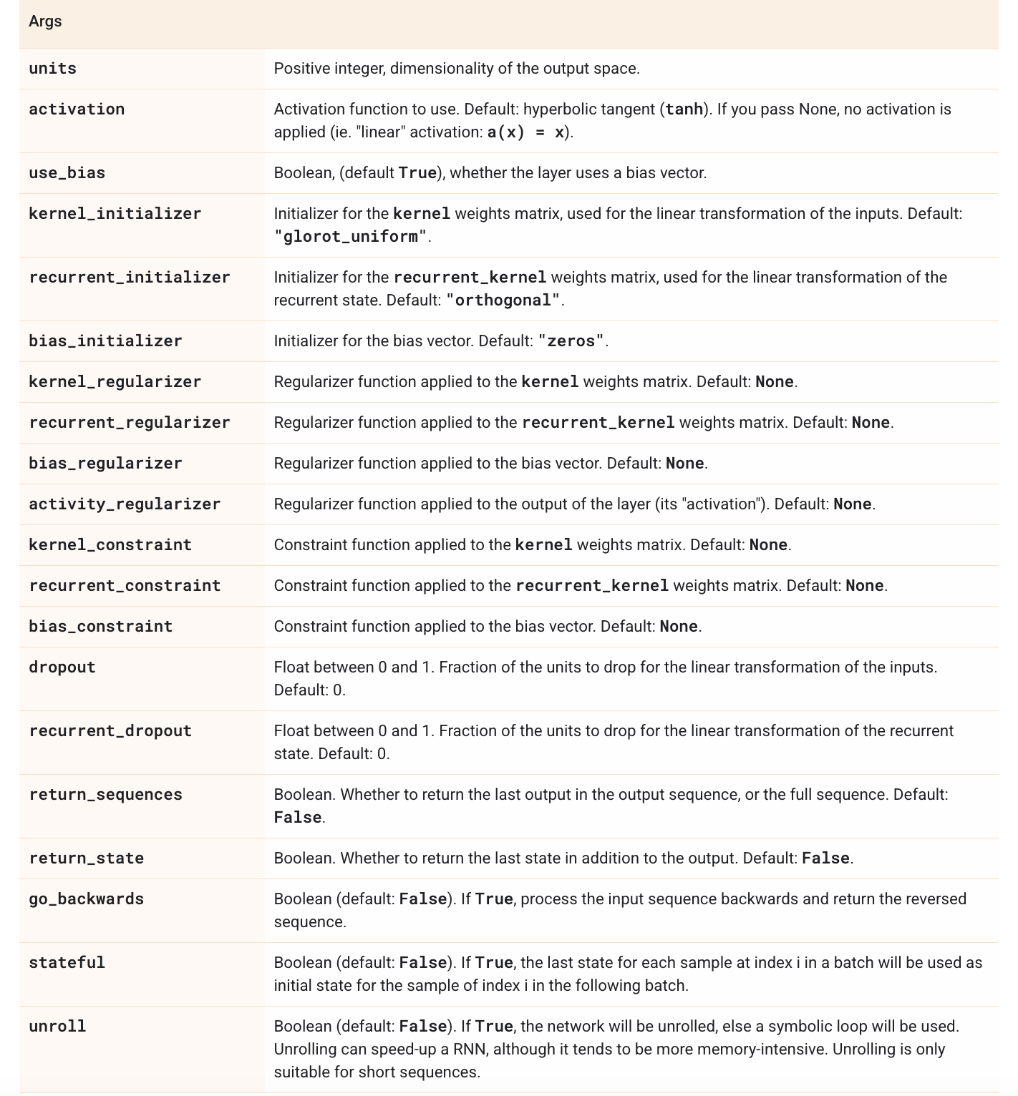
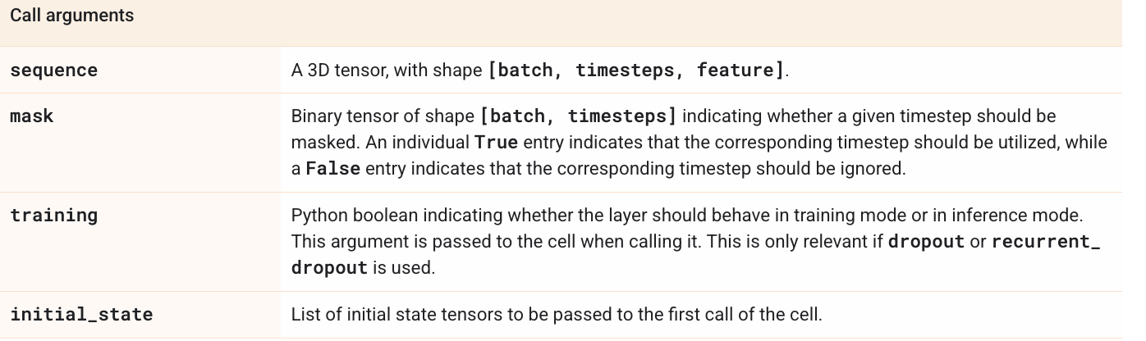

Slide 28
Introduction to Long Short Term Memory

Slide 29
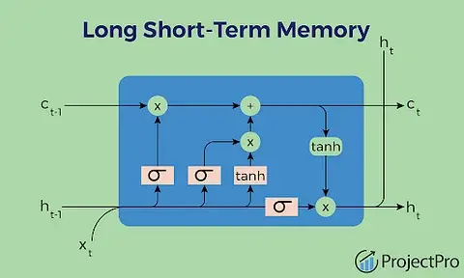
Long Short-Term Memory
LSTM, or Long Short-Term Memory, is a type of recurrent neural network (RNN) architecture designed to address the vanishing gradient problem and excel at capturing long-term dependencies in sequential data, making it suitable for tasks like natural language processing and time series prediction.

Slide 30
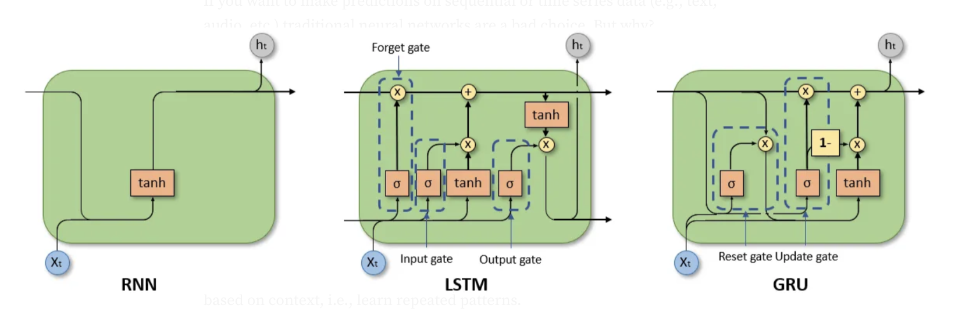

Slide 31
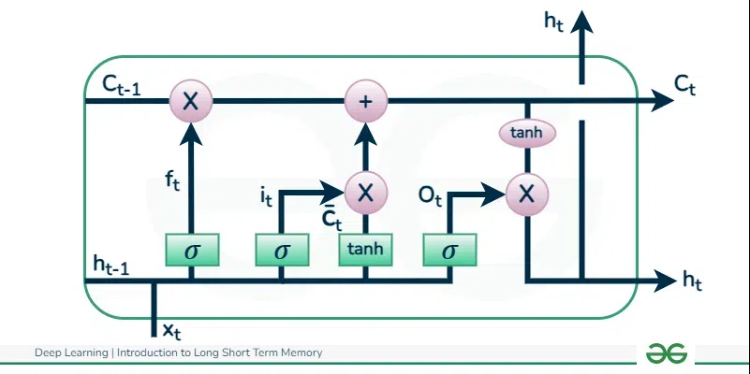
The term “Long Short-Term Memory” comes from the fact that the LSTM network is designed to handle both short-term and long-term dependencies in sequential data.
Long-term memory: Refers to the ability of the LSTM to remember information for extended periods of time. It can retain useful data over many time steps, which is crucial for tasks that involve long-range dependencies.
Short-term memory: Refers to the LSTM’s ability to capture immediate or recent context, which is important for tasks that rely on more immediate information.

Slide 32
How LSTM Works?
LSTM networks introduce memory cells, which have the ability to retain information over long sequences.
Each memory cell has three main components: an input gate, a forget gate, and an output gate.
The input gate determines how much of the new input should be stored in the memory cell. It takes the current input and the previous hidden state as inputs, and outputs a value between 0 and 1 for each element of the memory cell.
The forget gate decides which information to discard from the memory cell. It takes the current input and the previous hidden state as inputs, and outputs a value between 0 and 1 for each element of the memory cell. A value of 0 means the information is ignored, while a value of 1 means it is retained.
The output gate controls how much of the memory cell’s content should be used to compute the hidden state. It takes the current input and the previous hidden state as inputs, and outputs a value between 0 and 1 for each element of the memory cell.

Slide 33
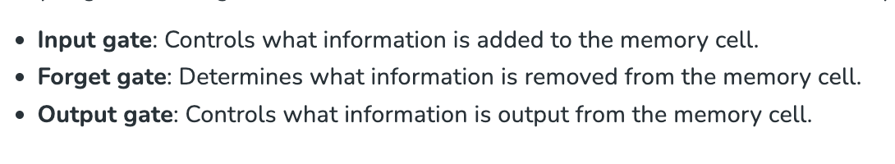
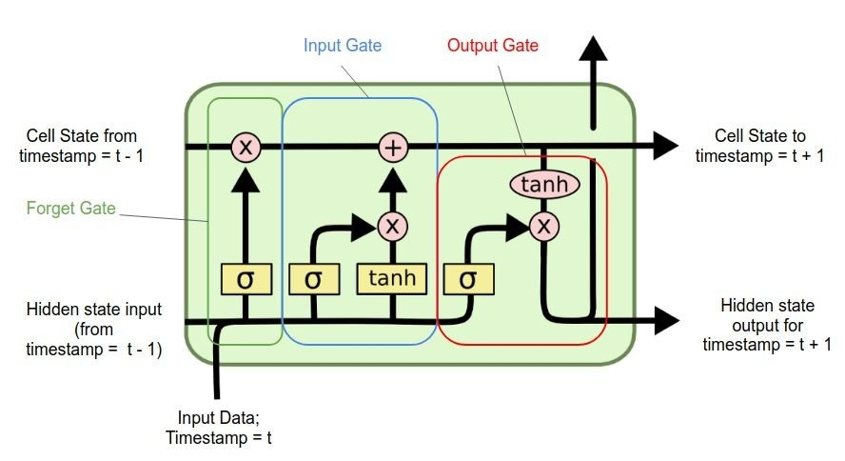

Slide 34
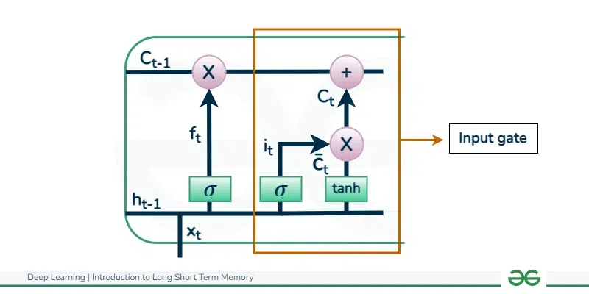
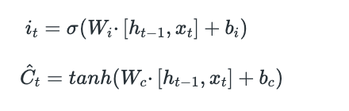
Input gate
The addition of useful information to the cell state is done by the input gate.
First, the information is regulated using the sigmoid function and filter the values to be remembered similar to the forget gate using inputs h_{t-1} and x_{t.} .
Then, a vector is created using tanh function that gives an output from -1 to +1, which contains all the possible values from h_{t-1} and x_{t}.
At last, the values of the vector and the regulated values are multiplied to obtain the useful information. The equation for the input gate is:

Slide 35
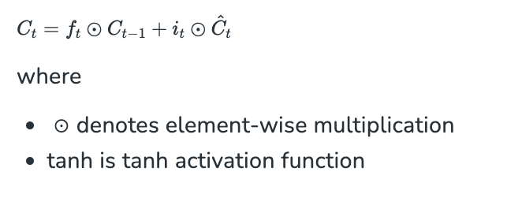
We multiply the previous state by f_{t}, disregarding the information we had previously chosen to ignore.
Next, we include i_{t}∗C_{t}. This represents the updated candidate values, adjusted for the amount that we chose to update each state value.

Slide 36
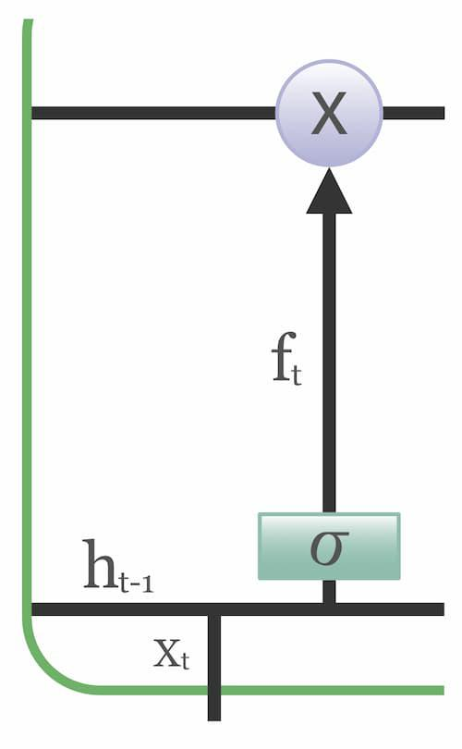
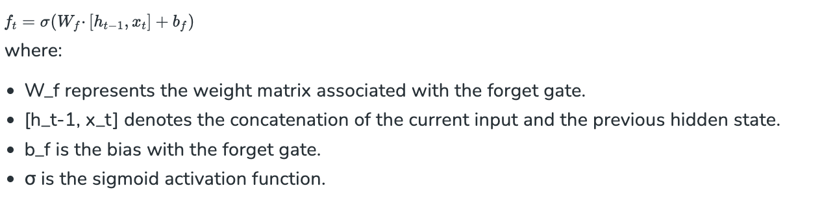
Forget Gate
The information that is no longer useful in the cell state is removed with the forget gate.
Two inputs x_{t} (input at the particular time) and h_{t-1} (previous cell output) are fed to the gate and multiplied with weight matrices followed by the addition of bias.
The result is passed through an activation function which gives a binary output. If for a particular cell state the output is 0, the piece of information is forgotten and for output 1, the information is retained for future use.
The equation for the forget gate is:

Slide 37
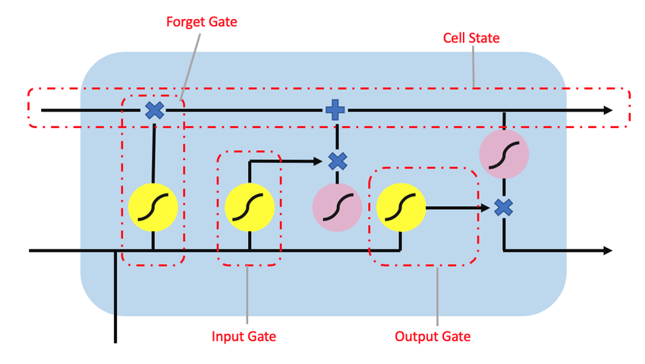
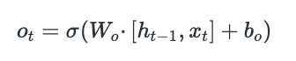
Output gate
The task of extracting useful information from the current cell state to be presented as output is done by the output gate.
First, a vector is generated by applying tanh function on the cell. Then, the information is regulated using the sigmoid function and filter by the values to be remembered using inputs ht−1 and xt​.
At last, the values of the vector and the regulated values are multiplied to be sent as an output and input to the next cell. The equation for the output gate is:

Slide 38
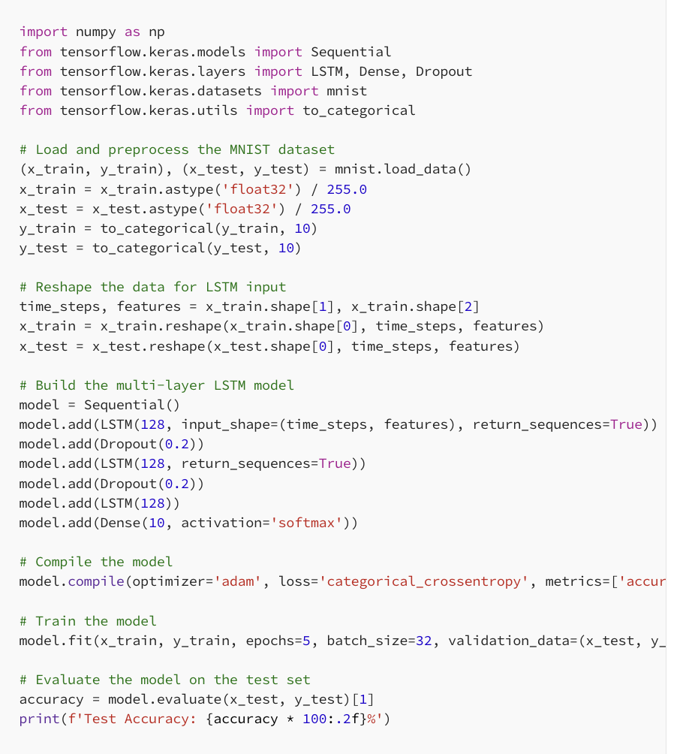
LSTM using Keras
Import Library
Load Data
Reshape the Data
Build Keras Model
Compile Keras Model
Fit and Train Model
Please Refer thttps://keras.io/api/layers/recurrent_layers/lstm/

Slide 39
Introduction to Gated Recurrent Unit

Slide 40
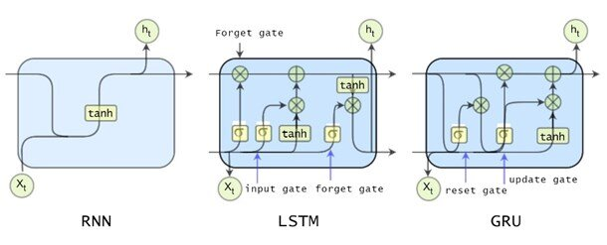
Gated Recurrent Unit
GRU stands for Gated Recurrent Unit, which is a type of recurrent neural network (RNN) architecture that is similar to LSTM (Long Short-Term Memory).
Like LSTM, GRU is designed to model sequential data by allowing information to be selectively remembered or forgotten over time.
However, GRU has a simpler architecture than LSTM, with fewer parameters, which can make it easier to train and more computationally efficient.

Slide 41
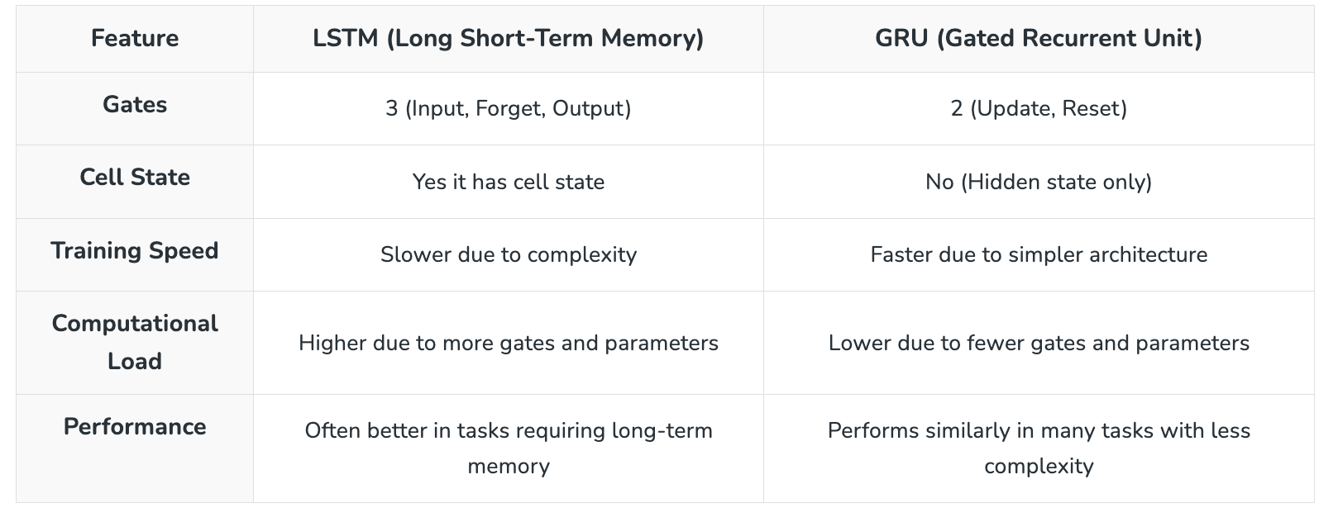

Slide 42
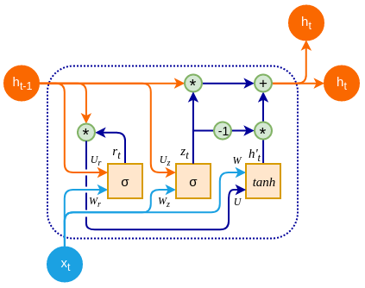
The GRU consists of two main gates:
Update Gate (zt​): This gate decides how much information from previous hidden state should be retained for the next time step.
Reset Gate (rt​): This gate determines how much of the past hidden state should be forgotten.
These gates allow GRU to control the flow of information in a more efficient manner compared to traditional RNNs which solely rely on hidden state.

Slide 43
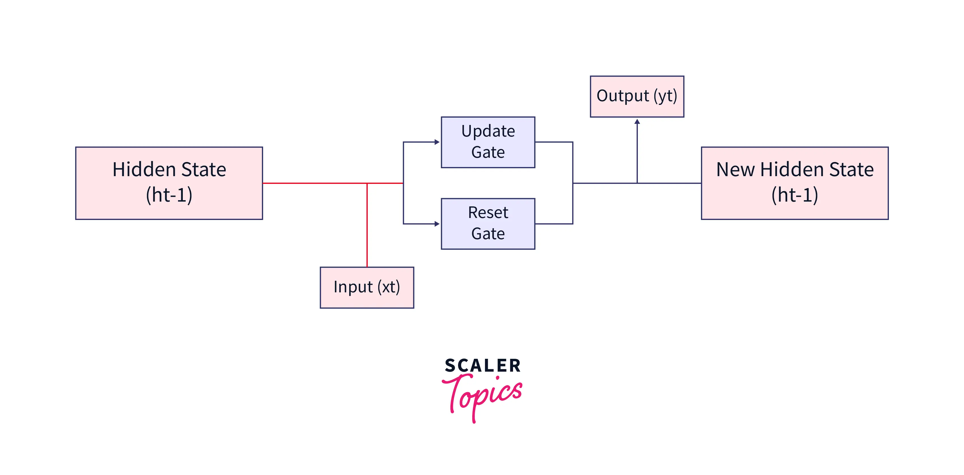
Note….
A GRU cell keeps track of the important information maintained throughout the network. A GRU network achieves this with the following two gates:
Reset Gate
Update Gate
Given below is the simplest architectural form of a GRU cell. As shown below, a GRU cell takes two inputs:
The previous hidden state
The input in the current timestamp.
The cell combines these and passes them through the update and reset gates.
To get the output in the current timestep, we must pass this hidden state through a dense layer with Softmax activation to predict the output.
Doing so, a new hidden state is obtained and then passed on to the next time step.

Slide 44
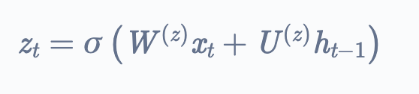
Update gate
An update gate determines what current GRU cell will pass information to the next GRU cell. It helps in keeping track of the most important information.
Let us see how the output of the Update Gate is obtained in a GRU cell.
The input to the update gate is the hidden layer at the previous timestep (h(t−1)​) and the current input (xt).
Both have their weights associated with them which are learned during the training process.
Let us say that the weights associated with h(t−1) is U(z), and that of xt​ is Wz​. The output of the update gate Zt​ is given by:

Slide 45
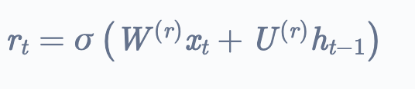
Reset gate
A reset gate identifies the unnecessary information and decides what information to be laid off from the GRU network.
Simply put, it decides what information to delete at the specific timestamp.
Let see how the output of the Reset Gate is obtained in a GRU cell. The input to the reset gate is the hidden layer at the previous timestep h(t−1) and the current input xt​.
Both have their weights associated with them which are learned during the training process.
Let us say that the weights associated with h(t−1) is Ur​, and that of xt​ is Wr​. The output of the update gate rt​ is given by,

Slide 46
Introduction to Unsupervised Learning in Deep Learning

Slide 47
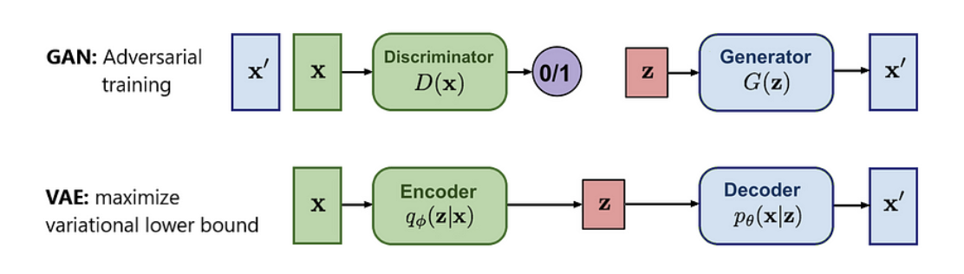
Unsupervised Learning in Deep Learning
Unsupervised learning in deep learning refers to the training of neural networks without labeled data.
Unlike supervised learning, where the model learns to map inputs to specific labels, unsupervised learning focuses on finding patterns, structures, or relationships in data without predefined outputs.

Slide 48
Introduction to Auto-Encoders

Slide 49
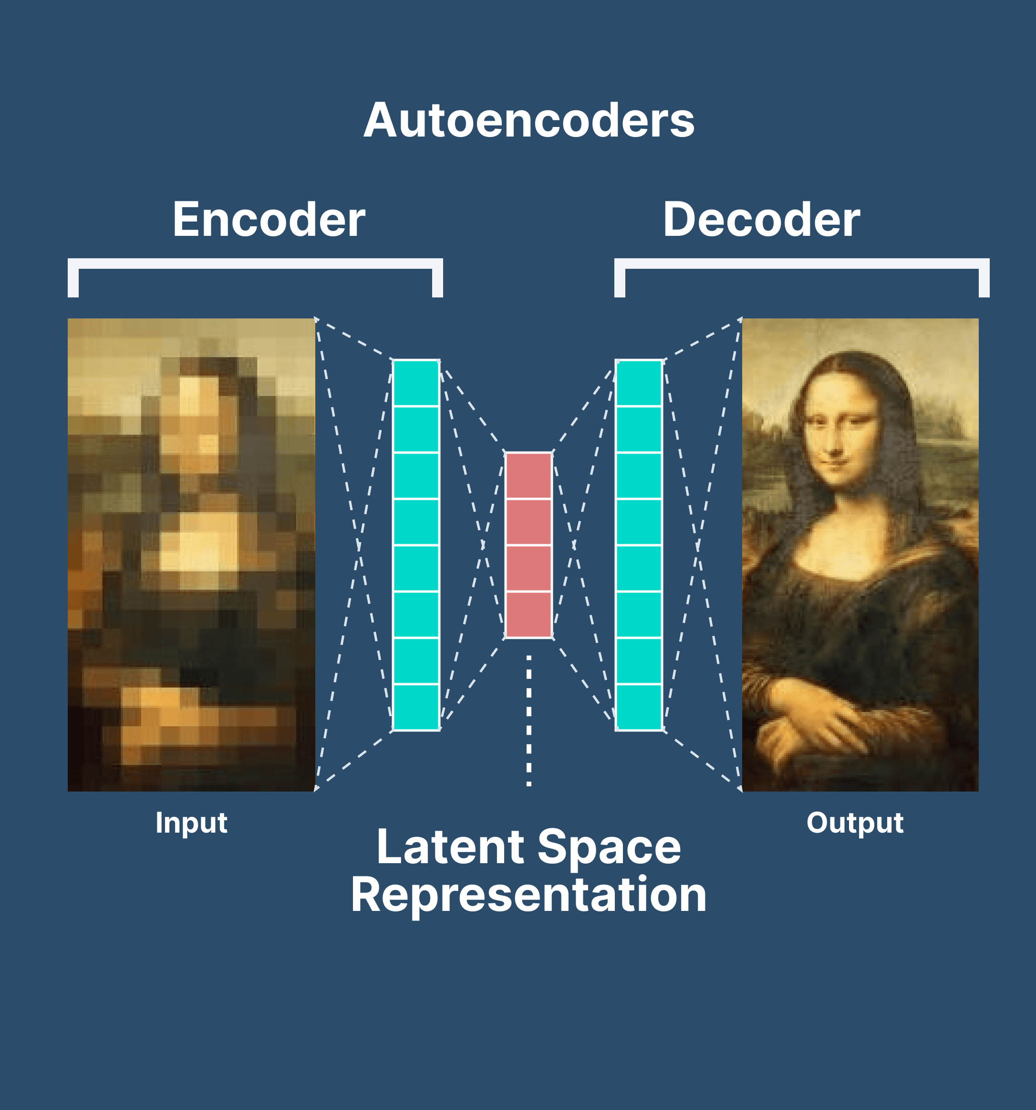
What is Auto-Encoder?
Autoencoders are an unsupervised learning technique in which we leverage neural networks for the task of representation learning.
An autoencoder is used to learn data encodings in an unsupervised manner.
The aim of an autoencoder is to learn a lower-dimensional representation (encoding) for a higher-dimensional data, typically for dimensionality reduction, by training the network to capture the most important parts of the input image.

Slide 50
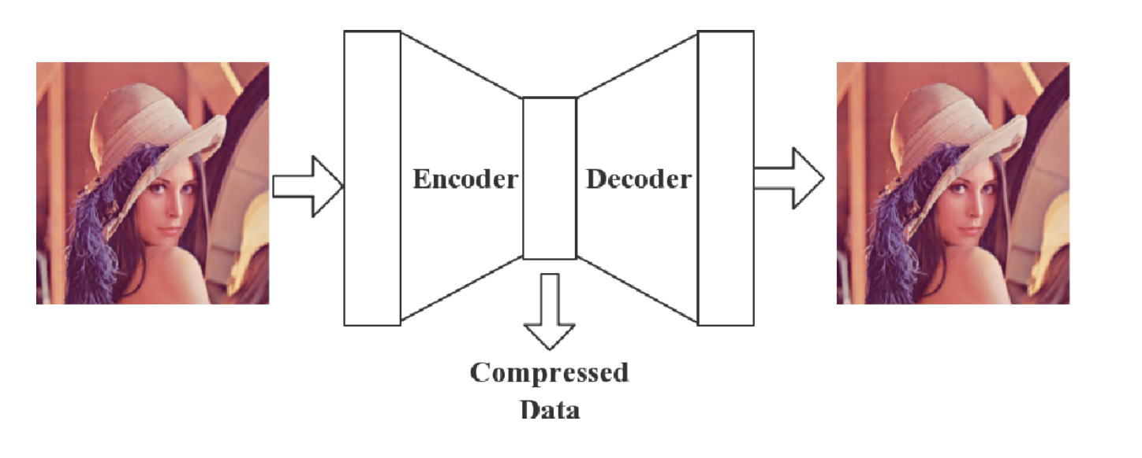

Slide 51
Architecture of Auto-Encoder
Auto-Encoder consists of three primary components: the encoder, the bottleneck, and the decoder.
1. Encoder:
The encoder is responsible for transforming the input data into a lower-dimensional representation, called the latent space or code.
It consists of one or more layers of neurons that progressively reduce the dimensionality of the input.
The encoder typically takes the input data and processes it through multiple layers (e.g., fully connected layers, convolutional layers, etc.) to extract features and encode the input into a compressed form.
Mathematically, the encoder maps the input x to a latent vector z (often referred to as the encoding):
z=f(x)
where f(x) is a function representing the encoder.
The goal of the encoder is to capture the most important features of the data, discarding redundant or irrelevant information.

Slide 52
Architecture of Auto-Encoder
2. Bottleneck/Latent Space:
The bottleneck is the compressed, low-dimensional representation of the input data that the model learns. It is the "center" of the autoencoder where the data is encoded into a smaller vector.
The bottleneck is crucial because it forces the model to learn a more compact and meaningful representation of the data.
The bottleneck can also be seen as the point of information compression.
The dimension of the bottleneck layer determines the level of compression. A smaller bottleneck will force the model to learn a more compressed representation, while a larger bottleneck might retain more information.
In mathematical terms, the bottleneck is the latent space, where:
Bottleneck (latent space)} = Z
The bottleneck is often referred to as the latent representation and is the central feature of the autoencoder's ability to perform tasks such as dimensionality reduction, denoising, or generating new data.

Slide 53
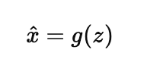
Architecture of Auto-Encoder
3. Decoder:
The decoder is responsible for reconstructing the input data from the compressed representation (latent vector) produced by the encoder.
The decoder typically mirrors the architecture of the encoder but works in reverse, expanding the representation back into the original data space.
The goal of the decoder is to map the latent vector z back to an approximation of the original input
g(z) is a function representing the decoder.
The decoder tries to minimize the reconstruction error (the difference between the input and the reconstructed output). This is typically done by optimizing the loss function during training, such as Mean Squared Error (MSE) or Binary Cross-Entropy, depending on the data type.
In essence, the decoder learns to reverse the compression performed by the encoder and regenerate the input from the latent space.

Slide 54
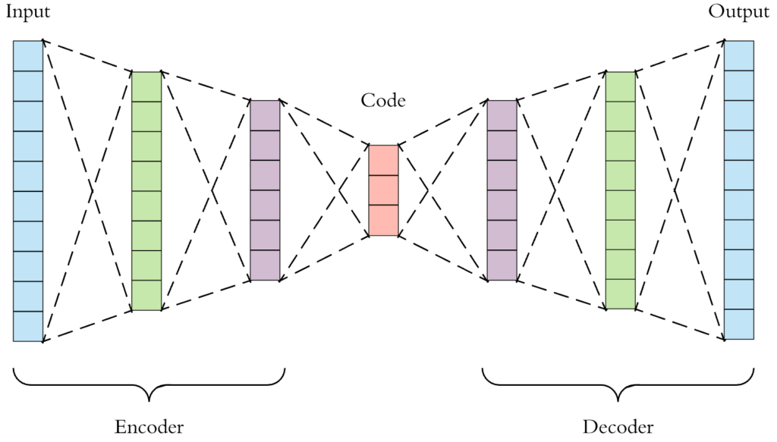
Type of Auto-Encoders
1. Vanilla Autoencoder (Standard Autoencoder):

Slide 55

2. Variational Autoencoder (VAE):
The Variational Autoencoder (VAE) introduces a probabilistic approach to the autoencoder model.
VAEs map inputs to a distribution (usually Gaussian), defined by a mean and variance in the latent space. The model then samples from this distribution to reconstruct the input.
This probabilistic nature enables VAEs to generate new data points by sampling from the learned distribution, making them powerful generative models.

Slide 56

VAE Architecture

Slide 57

Encoder: Learning a Distribution
In a VAE unlike autoencoder, the encoder doesn't directly produce a single compressed representation of the input data. Instead, it outputs the parameters of a probability distribution, typically a Gaussian distribution. This means the encoder gives us two things for each input:
Mean (μ): The center of the distribution.
Variance (σ²): The spread or uncertainty of the distribution. These parameters describe a range of possible values in the latent space that the input could correspond to, instead of just a single point.
Sampling: Adding Randomness
Now, we have a distribution for each input, but we need a specific point in the latent space to send to the decoder. This is where sampling comes in.
We randomly pick a point from the distribution given by the encoder. This process adds randomness to the model, which is important for generating diverse outputs. But, there's a problem with this direct sampling approach.

Slide 58

3. Convolutional Autoencoder (CAE):

Slide 59

4. Denoising Autoencoder (DAE):
A Denoising Autoencoder (DAE) is designed to learn a robust representation of data by training on noisy inputs.
During training, noise (such as random pixel corruption) is added to the input data, and the model learns to reconstruct the original, clean data from the noisy version.
This forces the model to capture underlying patterns in the data and learn to remove noise.

Slide 60

5. Sparse Autoencoder:
The Sparse Autoencoder is designed to promote sparsity in the activations of the hidden layer.
By introducing a sparsity constraint (often via L1 regularization or a penalty term like KL-divergence), the model encourages the latent space to represent only a few active neurons at any given time.

Slide 61


CAE using Keras

Slide 62


Slide 63

Please refer to https://blog.keras.io/building-autoencoders-in-keras.html for more information.

Slide 64
Introduction to Generative Adversarial Networks

Slide 65

Generative Adversarial Networks
To understand GANs at a basic level, imagine a game of cat and mouse, where the generator acts as the cat while the discriminator is the mouse.
The cat goals to create increasingly convincing "mice" to fool the mouse, while the mouse aims to distinguish between real and fake mice.
With each round, the cat improves at generating more realistic mice and the mouse sharpens its ability to tell real mice apart from fakes.

Slide 66


Slide 67


A generative adversarial network (GAN) has two parts:
The generator learns to generate plausible data. The generated instances become negative training examples for the discriminator.
The discriminator learns to distinguish the generator's fake data from real data. The discriminator penalizes the generator for producing implausible results.
When training begins, the generator produces obviously fake data, and the discriminator quickly learns to tell that it's fake:
As training progresses, the generator gets closer to producing output that can fool the discriminator:

Slide 68

Finally, if generator training goes well, the discriminator gets worse at telling the difference between real and fake. It starts to classify fake data as real, and its accuracy decreases.

Slide 69


Slide 70


Slide 71

Simple GAN using Keras
Please refer to https://keras.io/examples/generative/ for more information

Slide 72


Slide 73


Please refer to https://keras.io/examples/generative/ for more information

Slide 75


